Slide 1
AWS-Based Company Bankruptcy Prediction System
Cloud computing_DATS_6450
Final Project Part – B
Team – 8
Ambar Pathak, Vishesh Bhati, Aveline Mariya Shaji

Slide 2
Scope
The project encompasses a comprehensive bankruptcy prediction system built using machine learning models and Amazon Web Services (AWS) to predict the likelihood that a firm may go bankrupt. This will help us to assist in evaluating the financial health and stability of companies.
About the Data
Company Bankruptcy Prediction dataset: Kaggle
The data is collected from the Taiwan Economic Journal for the years 1999 to 2009
Company bankruptcy was defined based on the business regulations of the Taiwan Stock Exchange
The target variable is whether or not the company went bankrupt
The dataset includes a variety of financial ratios, such as profitability, liquidity, and leverage ratios
It contains data for over 6,800 companies over a period of 11 years
Number of Instances: 6,819
Number of Attributes: 96
2

Slide 3











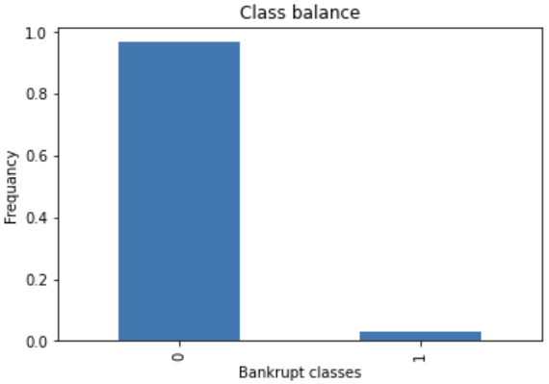
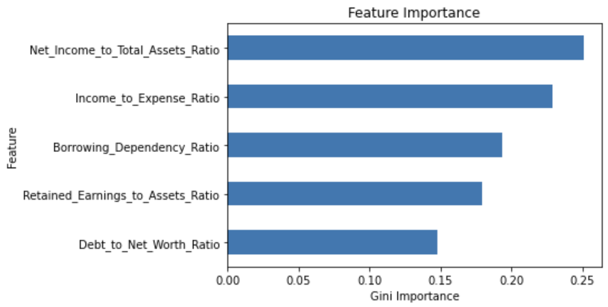
Machine Learning Model
CSV file import
Feature and Target Split
Feature Selection
Feature rename
Train-Test split
Handle Data Imbalance
Model Implementation
Model Evaluation
Prediction
96% accuracy

Slide 4



Features used for ML Implementation
Google Colaboratory for model building
Flask to link Python code to website

Slide 5






AWS Features
Region: Comprising multiple data centers to ensure high availability
Availability Zones (AZs): Physically isolated data centers, providing redundancy and fault tolerance
VPC(s) (Virtual Private Cloud): A private network to isolate and control resources and networking environment
EC2(s) (Elastic Compute Cloud): Scalable virtual servers to run applications
NAT Gateway: Allows private subnets to access the internet while remaining hidden from external traffic.
Application Load Balancer: To distribute incoming application traffic across multiple targets
Amazon Relational Database Service (Amazon RDS): Amazon RDS is a managed service that simplifies the setup, operation, and scaling of relational databases in the cloud

Slide 6
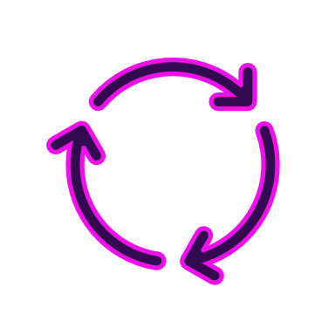
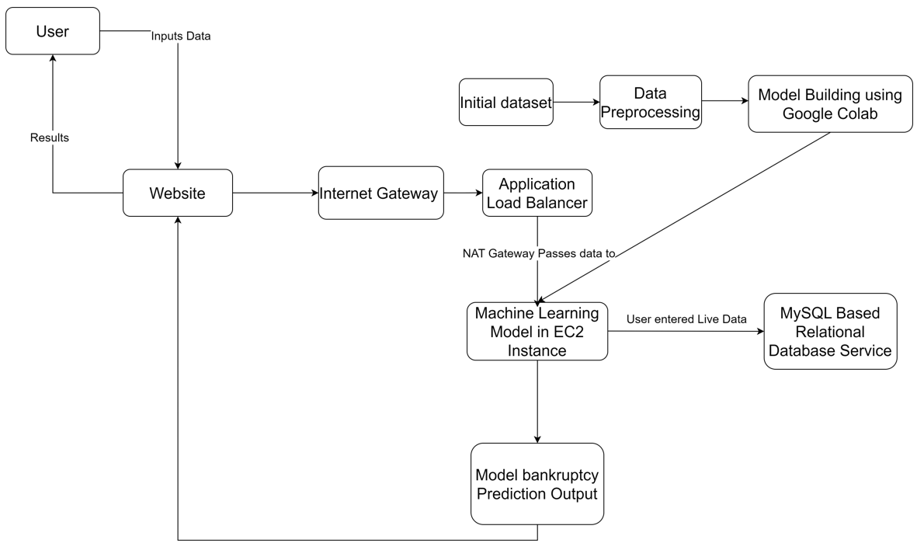
Data Flow

Slide 7
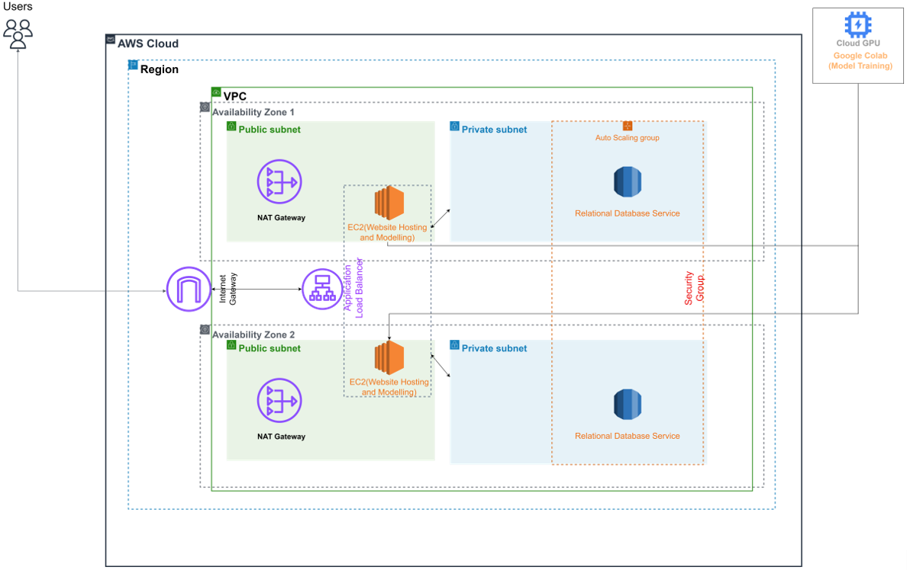
Project Architecture

Slide 8

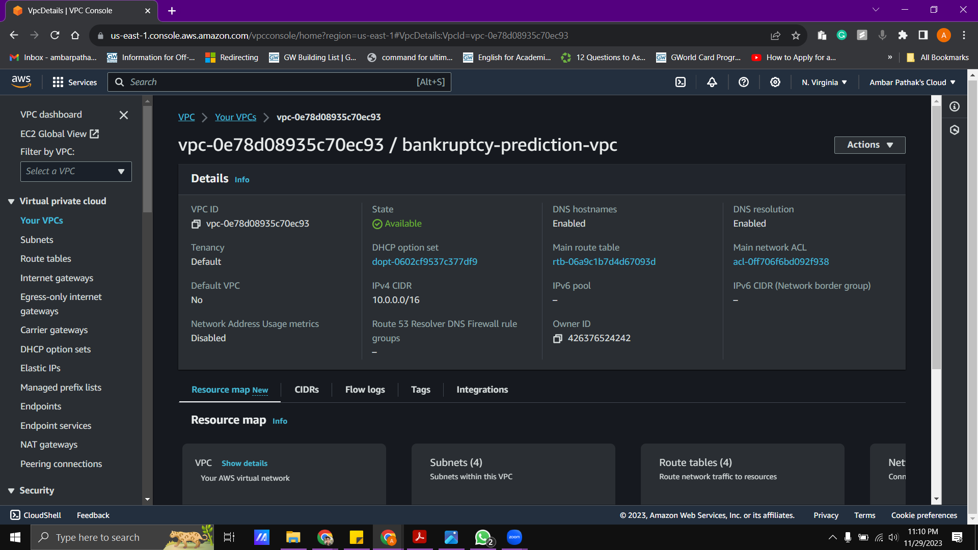
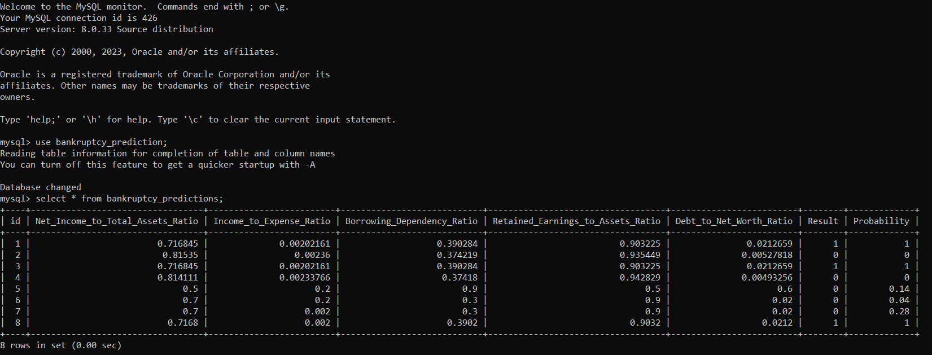
Cloud in Action

Slide 9
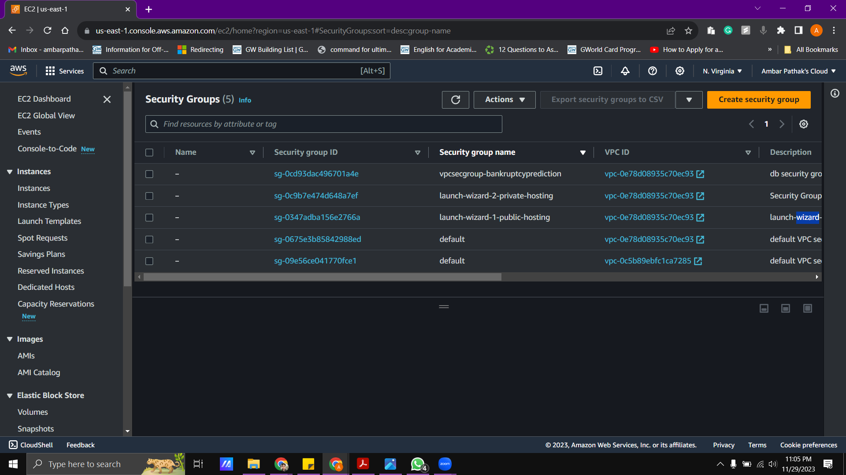
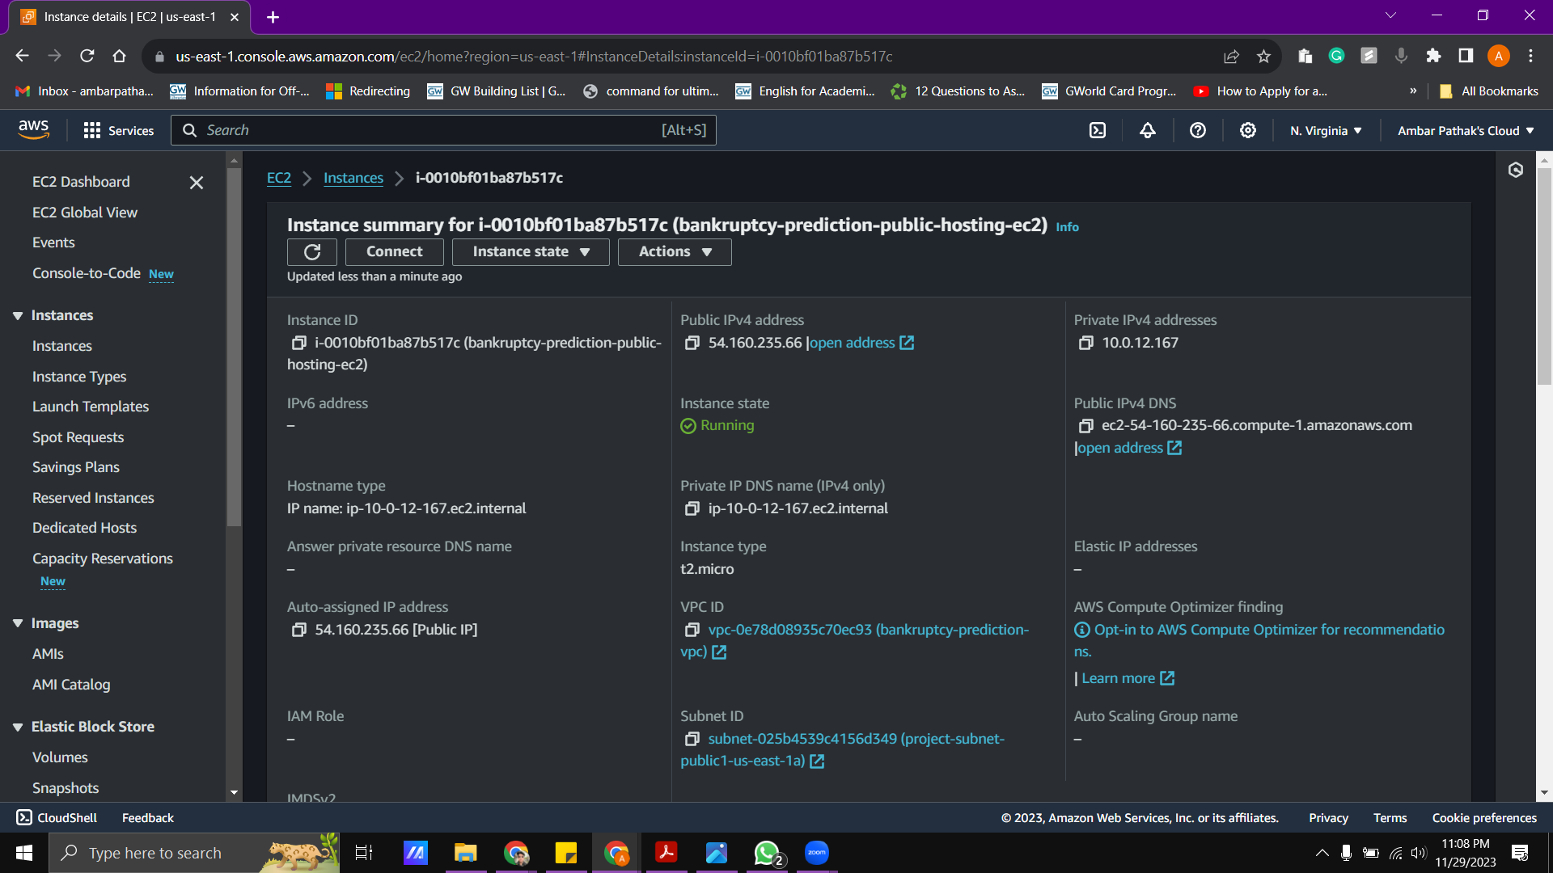
Cloud in Action

Slide 10
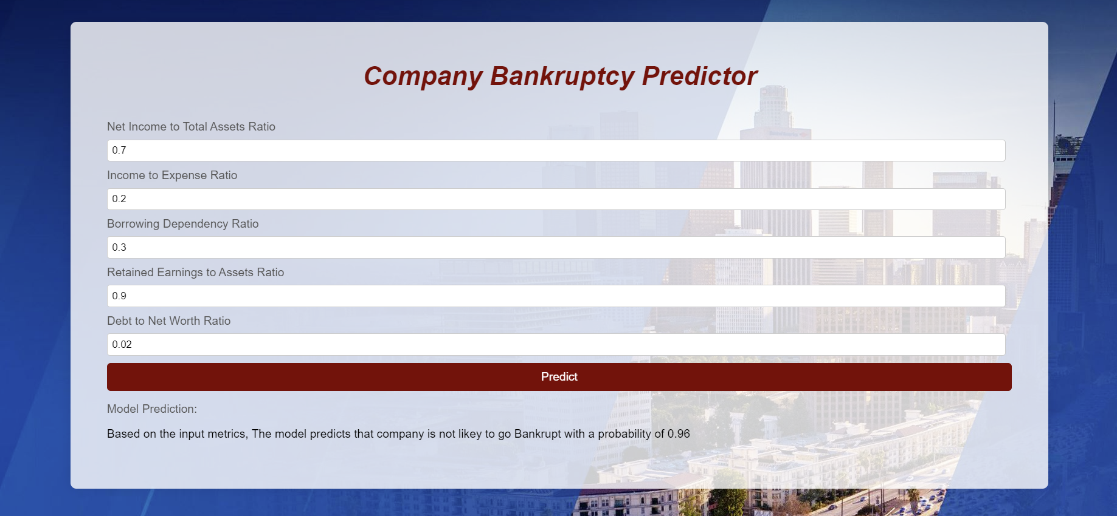
Outcome
Link- http://ec2-54-160-235-66.compute-1.amazonaws.com:8080/

Slide 11


GitHub
Link - https://github.com/ambar3497/Bankruptcy-Analysis-AWS
Reference
NAT Gateway
https://docs.aws.amazon.com/vpc/latest/userguide/vpc-nat-gateway.html\
Flask
https://flask.palletsprojects.com/en/3.0.x/
EC2
https://docs.aws.amazon.com/ec2/?nc2=h_ql_doc_ec2
Medium
https://medium.com/edureka/amazon-aws-tutorial-4af6fefa9941
Edureka- YouTube
https://www.youtube.com/watch?v=k1RI5locZE4

Slide 12
Thanks!

